Slide 1
ICE Quality Curation and Cytotoxicity Filtering

Slide 2
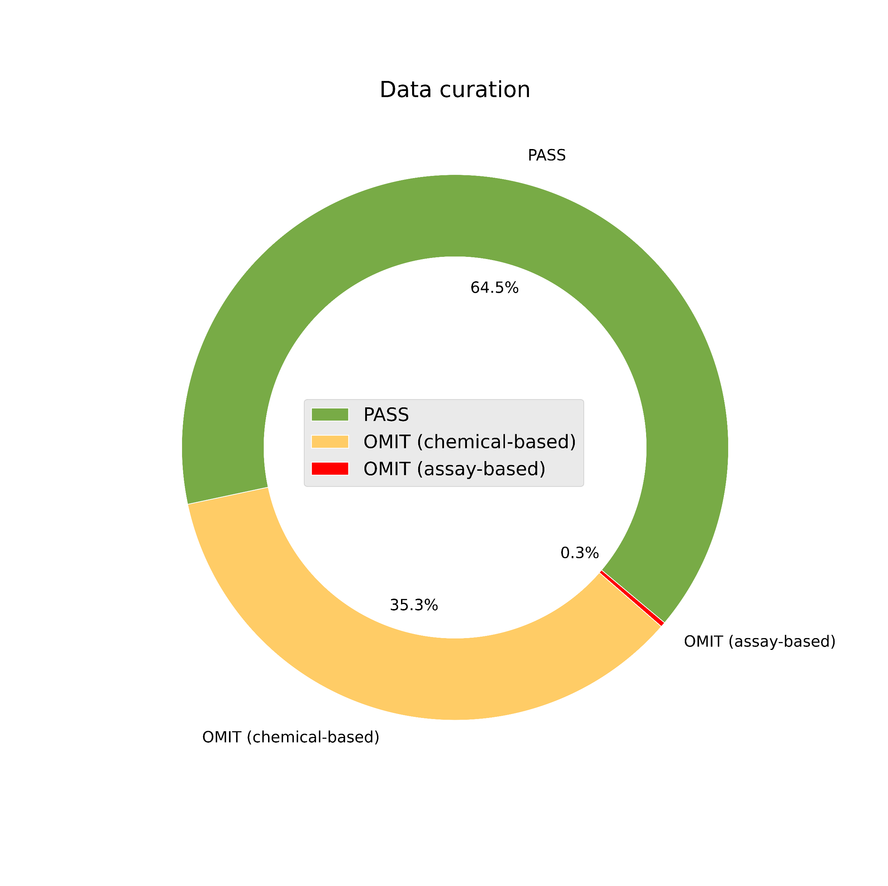
ICE QC

Slide 3
Cytotoxicity filtering
287 target assays
Active cases in target assays: 126877
Inactive cases in target assays: 959084
91 burst assays
47 viability assays

Slide 4
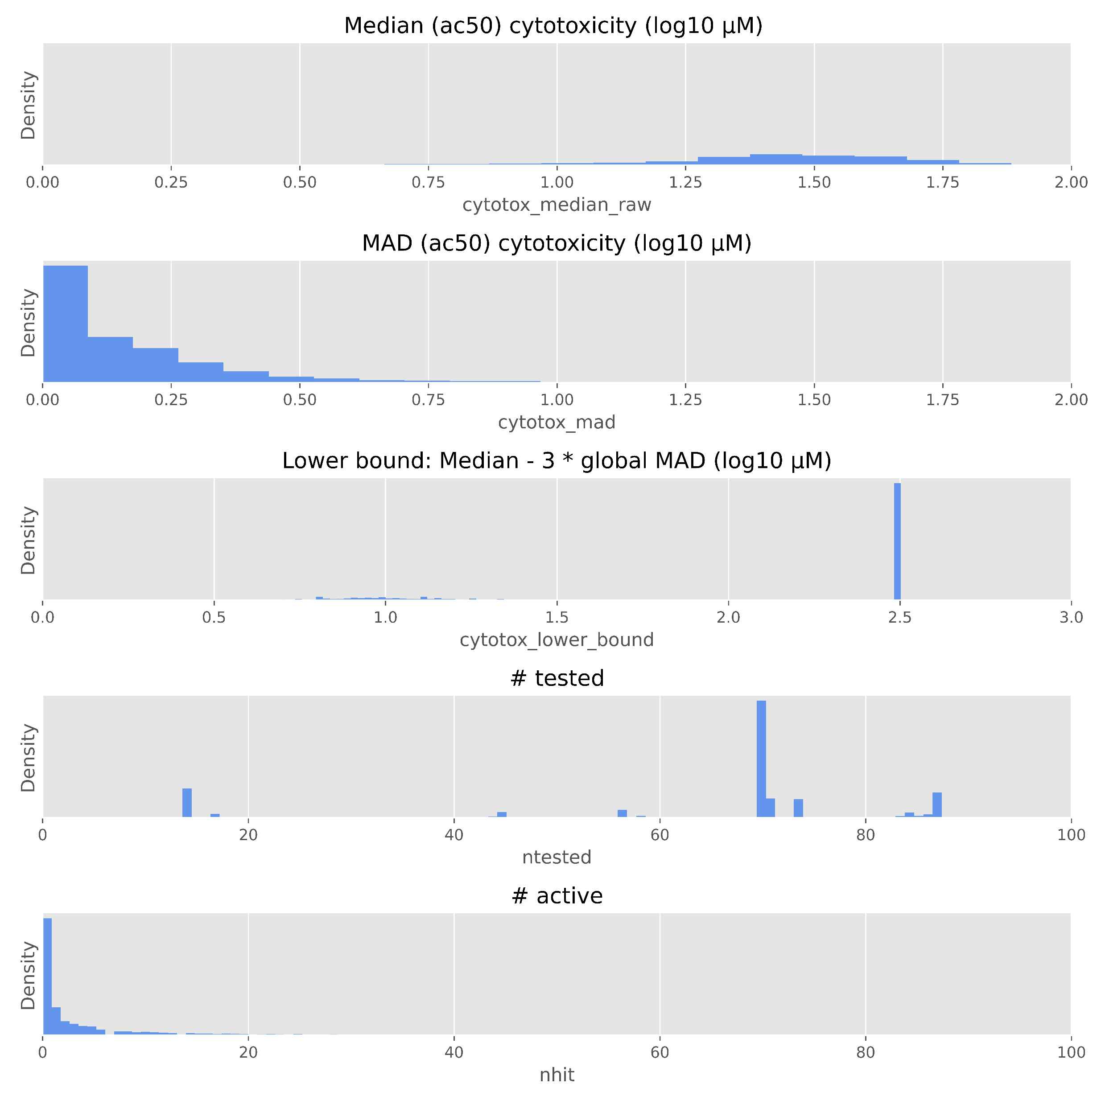
Burst assay cytotoxicity data

